Slide 1
Exposure of US Energy Production and GPD to Hurricanes
Vitor Ribeiro
Michael Bowes

Slide 2



Idea:
How much of the US energy production and GDP is exposed to Hurricanes and Hurricane related Business Interruption.
Core Information:
Where have Hurricanes historically made landfall in the US and are those areas big energy producers / economic centers?
Our Data includes:
(data broken down by state for Energy and by Latitude / Longitude)
GDP
Total Energy Production (2010 – 2014)
Hurricane Data from 1851 - Present

Slide 3

How much of our energy production and GDP is exposed to catastrophe?
We believed the question could be answered by obtaining energy production values and economic activity segmented by area along with a historical record of storms hitting the US.
Data Sources:
https://www.kaggle.com/noaa/hurricane-database
https://www.kaggle.com/lislejoem/us_energy_census_gdp_10-14

Slide 4

The Process
Use hurricane data to find which states have been historically affected.
Filter census/energy/gdp data to reflect only those states.
Determine overall economic exposure to hurricanes

Slide 5

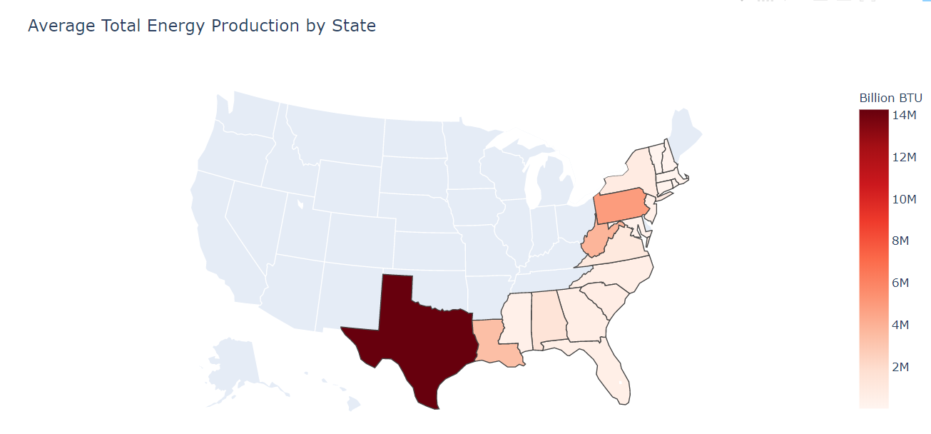
On the energy side
Take a broad view of energy production by State filtered to coastal areas susceptible to hurricane impact.
Energy Classes: Geo, Coal, Hydro, Elec, Fossil, Natural Gas
Average Total = Mean of 2010 – 2014 Total Production
Notes:
Data Cleanup & Exploration
Describe the exploration and cleanup process
Discuss insights you had while exploring the data that you didn't anticipate
Discuss any problems that arose after exploring the data, and how you resolved them
Present and discuss interesting figures developed during exploration, ideally with the help of Jupyter Notebook

Slide 6
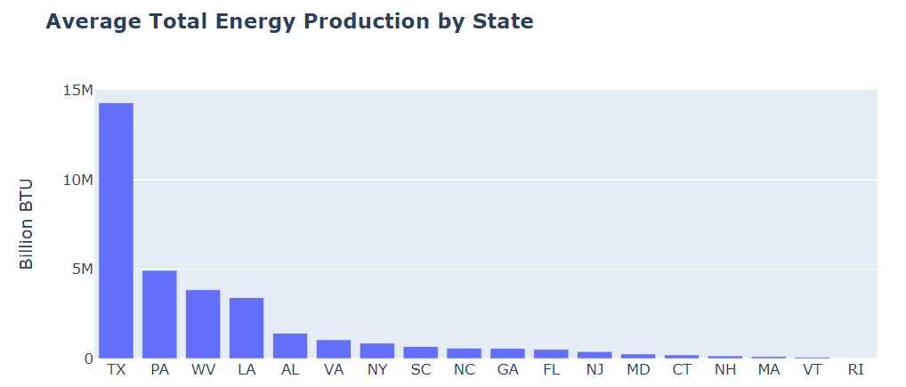
42%
33 Billion BTU out ~80 Billion BTU are produced in areas exposed to hurricanes in the Continental US

Slide 7
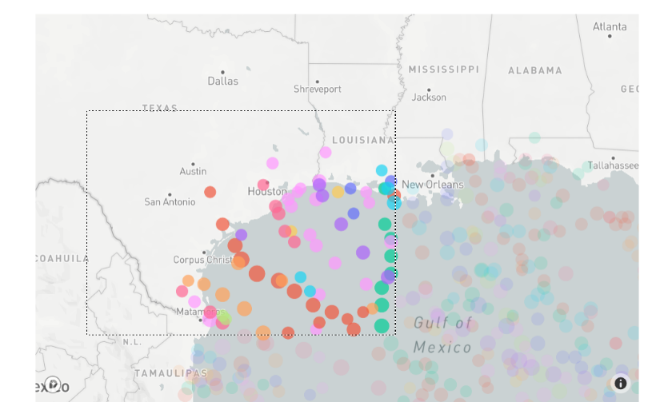
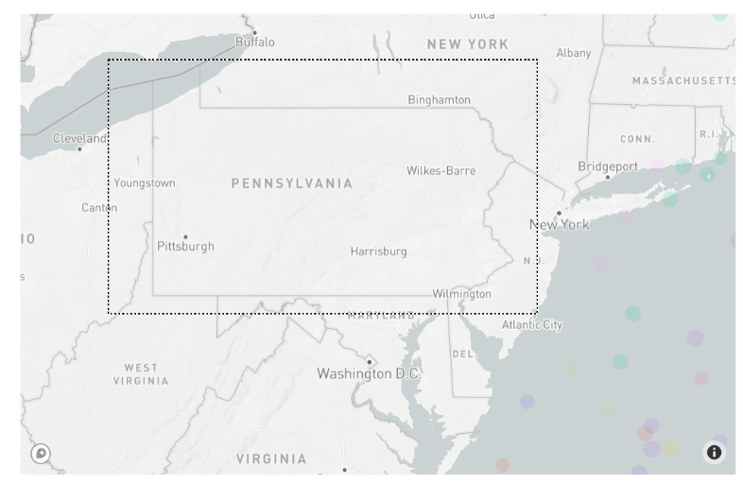
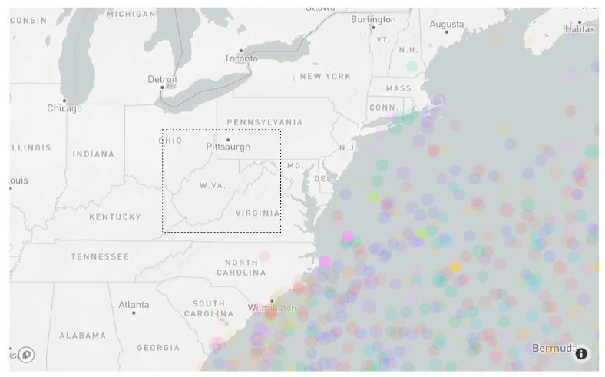
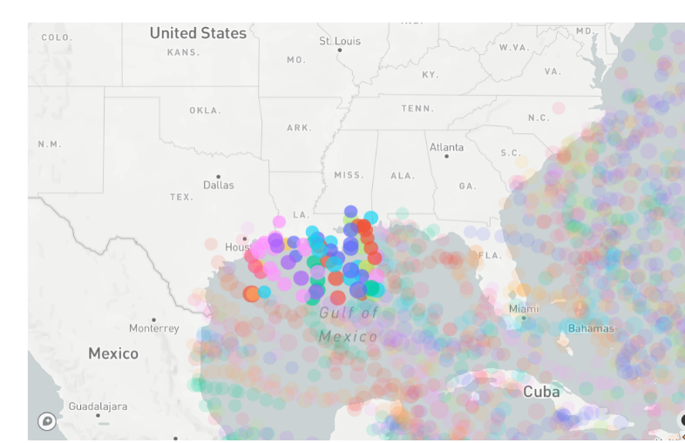
Top Four Energy Producers
Texas
Pennsylvania
West Virginia
Louisiana

Slide 8

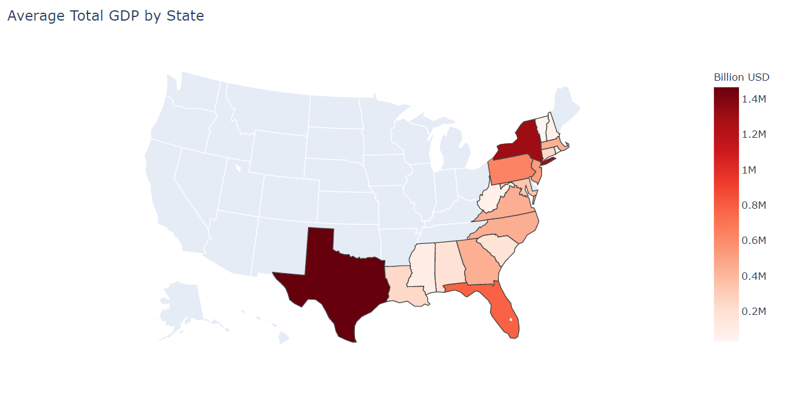
On the economic side
Take a broad view of GDP by State filtered to coastal areas susceptible to hurricane impact.
Average Total = Mean of 2010 – 2014 Total GDP
Notes:
Data Cleanup & Exploration
Describe the exploration and cleanup process
Discuss insights you had while exploring the data that you didn't anticipate
Discuss any problems that arose after exploring the data, and how you resolved them
Present and discuss interesting figures developed during exploration, ideally with the help of Jupyter Notebook

Slide 9
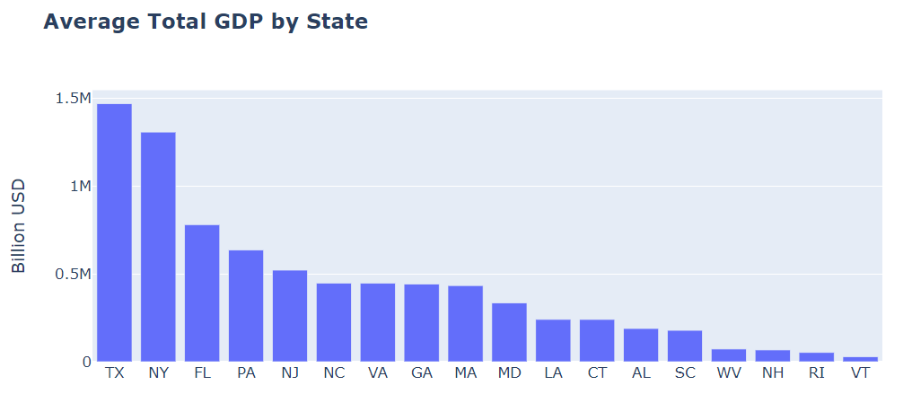
47%
Almost half of the US economy is in areas exposed to hurricanes in the Continental US

Slide 10
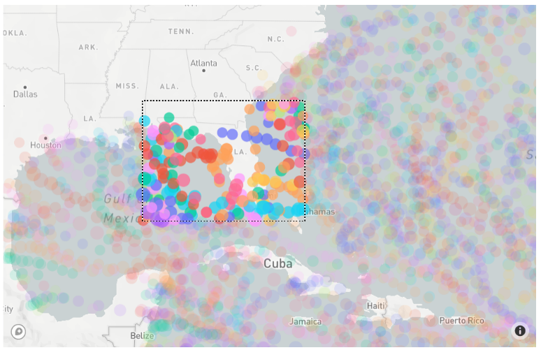
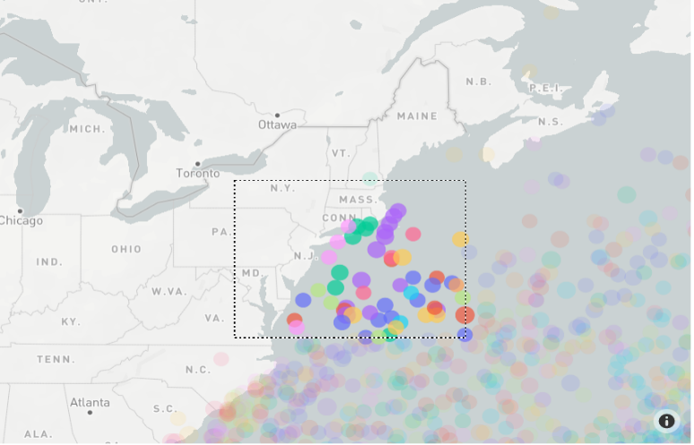
Top Four GDP
Texas
Pennsylvania
Florida
New York

Slide 11

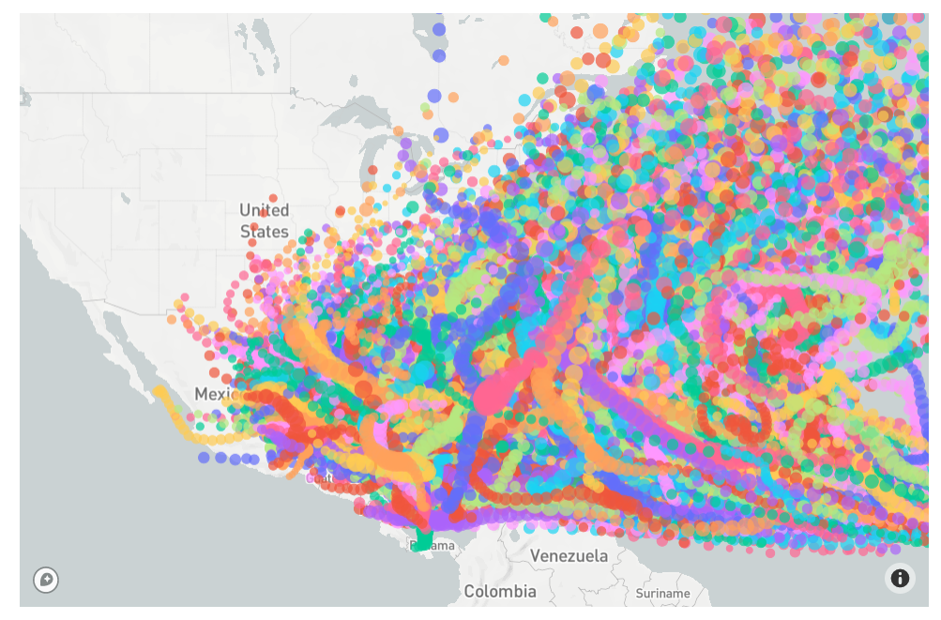
On the hurricane side
Try to tie hurricane tracks to specific named locations = “EXTREMELY DIFFICULT, AVOID”
Notes:
Data Cleanup & Exploration
Describe the exploration and cleanup process
Discuss insights you had while exploring the data that you didn't anticipate
Discuss any problems that arose after exploring the data, and how you resolved them
Present and discuss interesting figures developed during exploration, ideally with the help of Jupyter Notebook

Slide 12
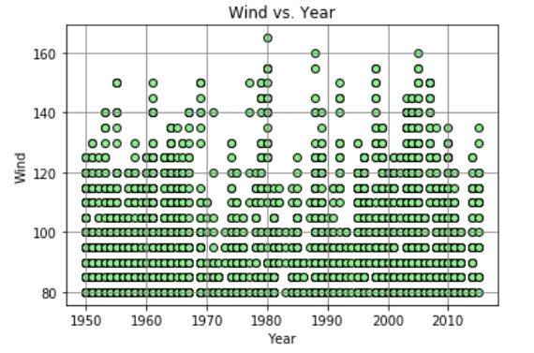
Historical Hurricane Pattern – No distinguishable Pattern
Naming Conventions of Hurricanes started in 1950 and historical data shows no clear pattern based on # of Hurricanes, Wind Speed and Year.

Slide 13
Difficulties
The first difficulty we encountered was filtering the Latitudes and Longitudes in any meaningful way. We tried to create batches (similar to HeroesOfPymoli - Age Groups) but could only find a method that checked 1 coordinate (data contains 40,000+ coordinates) at a time.
We also tried to create a centroid (and state polygons) with a radius around it but found difficult to filter data that way too.
In order to chart the path of the hurricanes we used the mapbox API which provides a public token to use in their maps.
Notes:
Data Cleanup & Exploration
Describe the exploration and cleanup process
Discuss insights you had while exploring the data that you didn't anticipate
Discuss any problems that arose after exploring the data, and how you resolved them
Present and discuss interesting figures developed during exploration, ideally with the help of Jupyter Notebook

Slide 14
General Discussion
Business Interruption caused by evacuation and damage can be quite significant in some of these areas. Our data suggests that New York and Texas are especially vulnerable given the size of their economies.
If divided by day New York contributes around 4 Billion USD to the national GDP.
Of the biggest energy producers in our data the “safest” states are West Virginia and Pennsylvania which are some of the countries biggest coal producers.
West Virginia is 2nd nation-wide in the production of coal derived energy.
https://www.eia.gov/state/maps.php

Slide 15
General Discussion
Warming waters means unpredictable hurricane behavior.
The ideal conditions for a hurricane include a water temperature of ~80F and a depth of at least 165ft. As the ocean temperature rises hurricanes have more energy to move in erratic patterns and recharge.

Slide 16
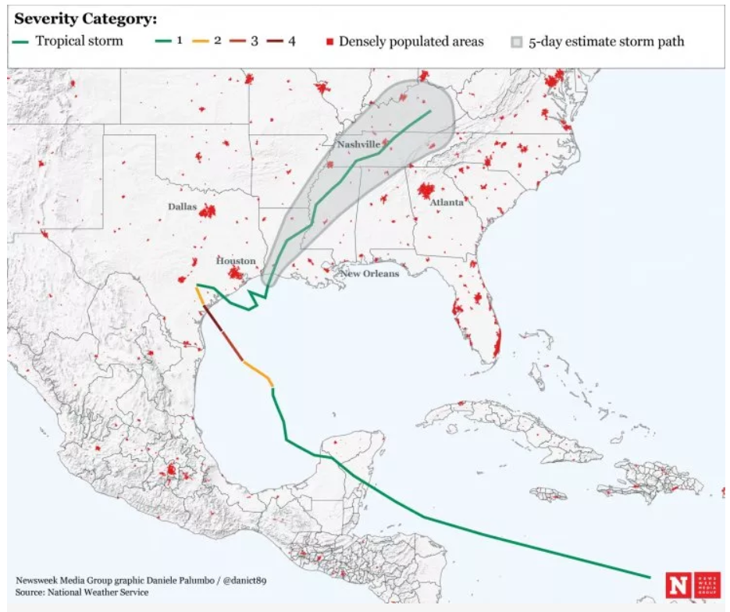
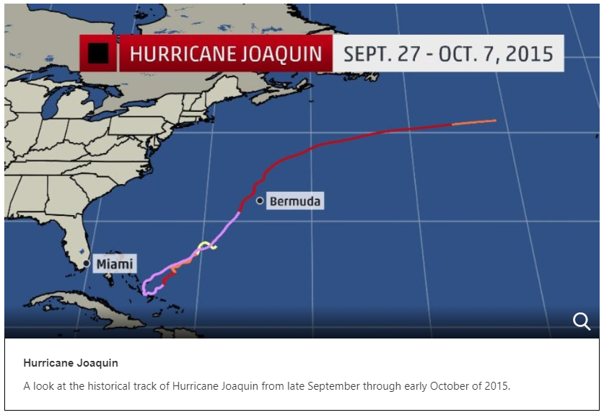
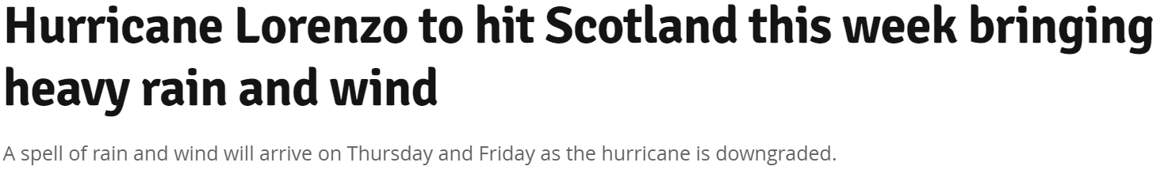
Erratic Hurricane Behavior

Slide 17
Q&A

